Slide 1
Patterns in Types Of Restaurants
in New York
VARSHA GADEKAR
NOV 11, 2020

Slide 2
Problem
The project aims to find out if there is any pattern in the type of restaurants located in every borough and neighborhood of New York.
Are some cuisines / types of restaurants more represented in certain areas than in others?
Which cuisines / types of restaurants have delivery options?
Is it possible to group neighborhoods together based on the sole criteria of food?
Which borough has the most restaurants?
The project will also focus on the borough with most restaurants in New York and provide a list of top restaurants based on user ratings and likes and dine-out and delivery services considering current covid scenarios.

Slide 3
Data acquisition and cleaning
Neighborhood has a total of 5 boroughs and 306 neighborhoods. In order to segment the neighborhoods and explore them, we will essentially need a dataset that contains the 5 boroughs and the neighborhoods that exist in each borough as well as the latitude and longitude coordinates of each neighborhood
This dataset exists for free on the web. Here is the link to the dataset: https://geo.nyu.edu/catalog/nyu_2451_34572.
Geopy library was used to get the latitude and longitude values of New York City
Foursquare API was utilized to explore all the neighborhoods and segment them. The API was also used to get details of venue
For the project only the following features were selected :
borough -> Borough
Name -> Neighborhood
Coordinates -> Latitude, Longitude

Slide 4
Methodology
In this project we will direct our efforts on:
Detecting patterns in the type of restaurants located in every borough and neighborhood of New York. We will limit our analysis to area 500m radius.
collected the required data: location and type (category) of every restaurant within 500m radius.
calculation and exploration of 'restaurant density' across different areas of New York.
clustering neighborhoods and boroughs based on types of restaurants

Slide 5
Data Analysis

Slide 6
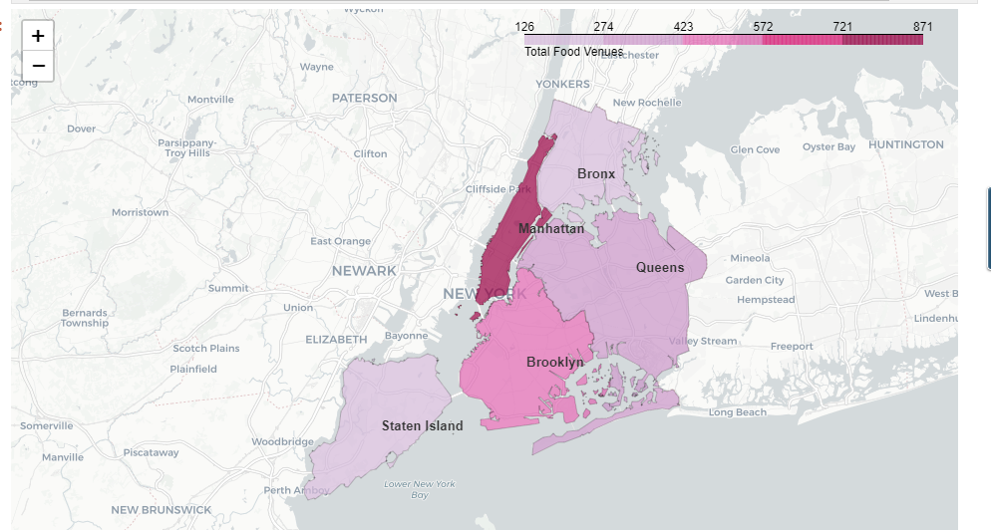
Density of restaurants in New york
Borough:
From the above map we can conclude that Manhattan has the highest number of restaurants.

Slide 7
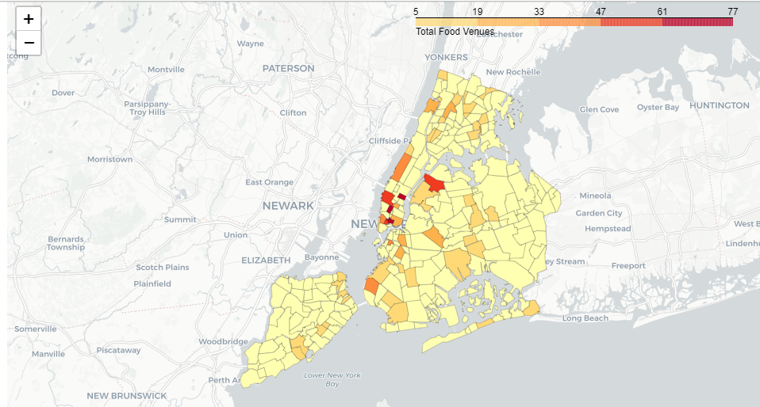
Nieghborhood:

Slide 8
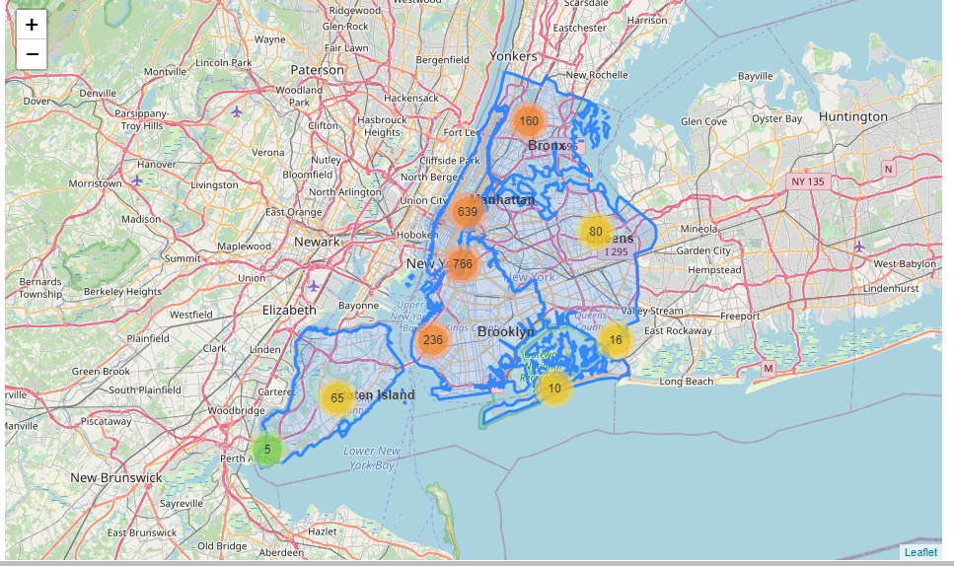
Numerical vision:

Slide 9
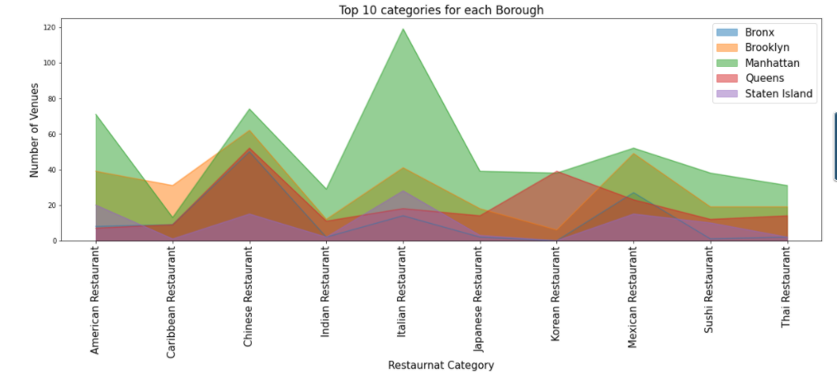
Top 10 categories based on density
In Manhattan most popular are Italian restaurant
ALL the Boroughs has almost equal popularity for Chinese Restaurants
Brooklyn, Manhattan, Queens have almost similar popularity in types of restaurants

Slide 10
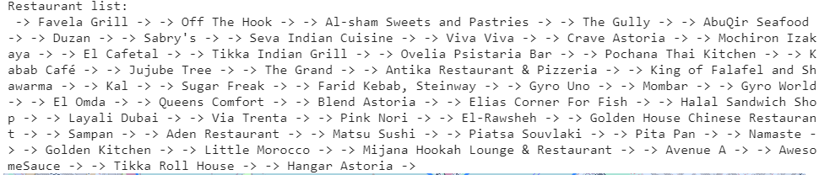
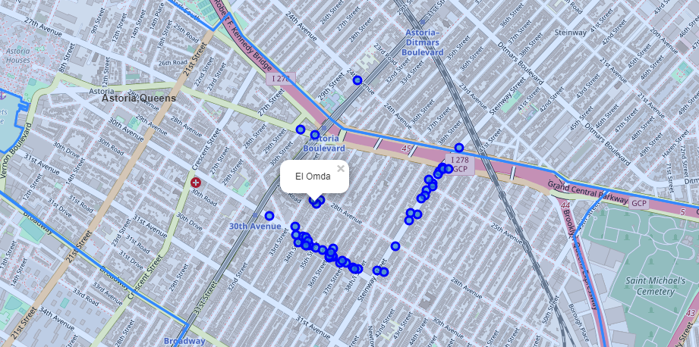
Restaurants density based on delivery option
Most of the restaurants provide home delivery options in New York.
Function was created which lists and display all the restaurants in a neighborhood which provide home delivery option you just need to pass the name of neighborhood and borough.
For neighborhood_name='Astoria' and borough_name='Queens' output:

Slide 11
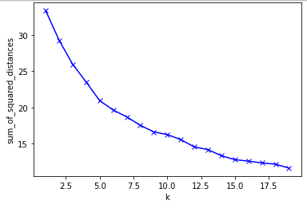
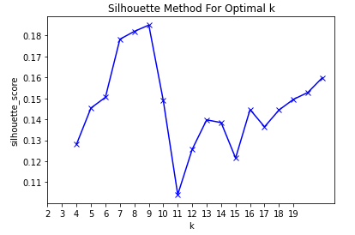
Modeling -k means clustering
an unsupervised machine learning technique used to identify clusters of data objects in a dataset
Find an optimal value for k
The Elbow method -> The Silhouette Method
k=9 is optimal value

Slide 12
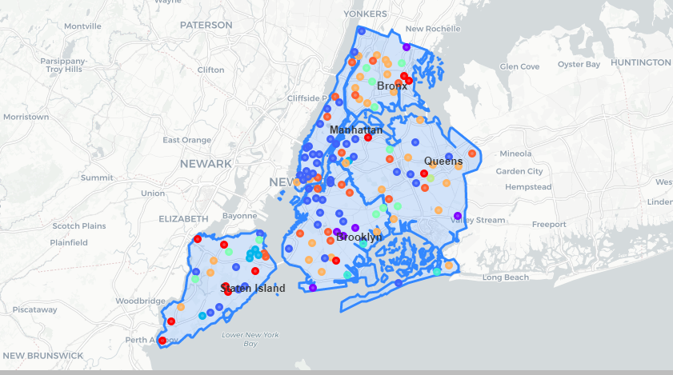
Neighborhood clustered

Slide 13
Conclusions
There are a great number of restaurants in New York
Manhattan has the largest number of restaurants among all boroughs.
People of Manhattan love Italian food.
There are 83 types of food category/cuisines in New York among which the top 10 based on density are : Chinese, Italian, Mexican, American, Korean, Sushi, Japanese, Thai, Caribbean and Indian.
Most of the restaurants provide food delivery options so if you want to grab a bite from the comfort of your own place then you can just ask for home delivery.
Then we clustered the neighborhood data to find out if there is any relation between the neighborhood based on types of food and we found out neighborhoods who have similar food tastes.

